Slide 1



Bootstrap 5
Chapter-4
Exploring Bootstrap components
Notes:
Hello, everyone! Welcome to Aitrich Academy. Now, we are presenting Bootstrap 5, Chapter –Exploring Bootstrap components.

Slide 2
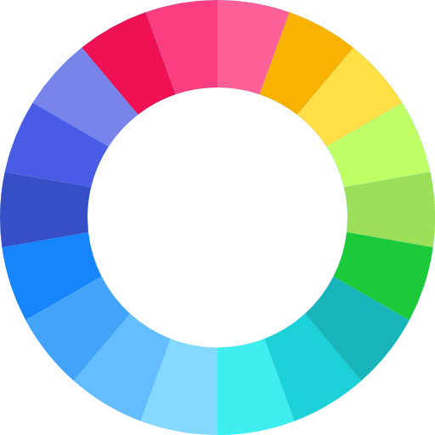
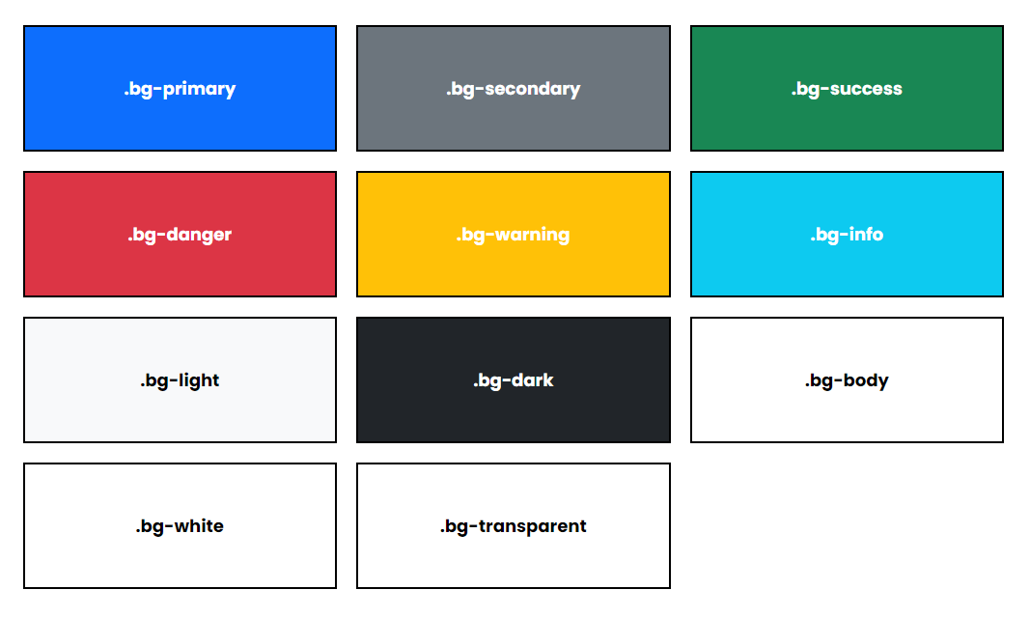
Bootstrap 5 Colors
Bootstrap5 has some contextual classes that can be used to provide “Meaning through colors”.
.text-primary
.text-danger
.text-success
.text-warning
.text-dark
.text-info
Notes:
Bootstrap 5 Colors
Bootstrap5 has some contextual classes that can be used to provide “Meaning through colors”.
.text-primary
.text-danger
.text-success
.text-warning
.text-dark
.text-info

Slide 3

Bootstrap Example
<p class="text-primary">Primary link</p>
<p class="text-secondary">Secondary link</p>
<p class="text-success">Success link</p>
<p class="text-danger">Danger link</p>
<p class="text-warning">Warning link</p>
Notes:
In this example, we'll explore how Bootstrap's text color classes can be applied to paragraphs, with each paragraph representing a different color. The first line of code applies the .text-primary class to a paragraph element, resulting in text with the primary color defined by Bootstrap. Subsequent paragraphs utilize other color classes, each providing a unique output as shown.

Slide 4
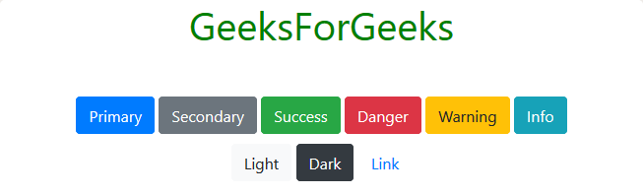
Buttons
Buttons: Bootstrap provides a versatile set of button styles, sizes, and states. You can create primary, secondary, outline, and various other button styles.
<button type="button" class="btn btn-primary">Primary</button>
<button type="button" class="btn btn-secondary">Secondary</button>
<button type="button" class="btn btn-success">Success</button>
<button type="button" class="btn btn-danger">Danger</button>
<button type="button" class="btn btn-warning">Warning</button>
<button type="button" class="btn btn-info">Info</button>
<button type="button" class="btn btn-light">Light</button>
<button type="button" class="btn btn-dark">Dark</button>
<button type="button" class="btn btn-link">Link</button>
Notes:
Buttons
Buttons:
Bootstrap provides a versatile set of button styles, sizes, and states. You can create primary, secondary, outline, and various other button styles. Here is an example code snippet to explore how Bootstrap’s btn and .btn-color classes can be applied to buttons, along with its output.

Slide 5
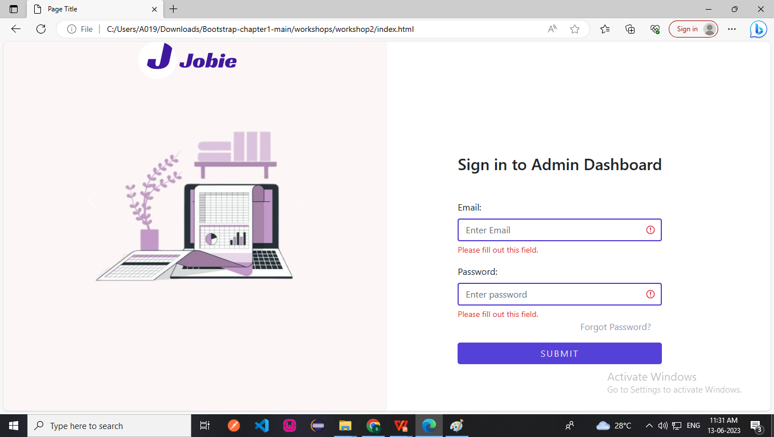
Forms
Forms: Bootstrap offers a collection of form components, including input fields, checkboxes, radio buttons, select dropdowns, and more. You can also utilize form validation and customization options.
Notes:
Forms
Forms: Bootstrap offers a collection of form components, including input fields, checkboxes, radio buttons, select dropdowns, and more. You can also utilize form validation and customization options.

Slide 6
Navbars
A navigation bar is a navigation header that is placed at the top of the page
With bootstrap, a navigation bar can extend or collapse.
A standard navigation bar is created with the .navbar class, followed by a responsive collapsing class.
Notes:
Navbars
A navigation bar is a navigation header that is placed at the top of the page
With Bootstrap, a navigation bar can extend or collapse.
A standard navigation bar is created with the .navbar class, followed by a responsive collapsing class.
Here is also the example for applying the bootstrap navbar class to create a header.

Slide 7
Images
The .rounded class adds rounded corners to an image.
The .rounded-circle class shapes the image to a circle
img-thumbnail class shapes the image to a thumbnail.
Notes:
Images
The .rounded class adds rounded corners to an image.
The .rounded-circle class shapes the image into a circle.
img-thumbnail class shapes the image into a thumbnail.

Slide 8
Alerts
Bootstrap provides an easy way to create predefined alert messages.
Alerts are created with the .alert class, followed by the contextual classes.
.alert-success , .alert-info , .alert-warning etc.
Notes:
Alerts
Bootstrap provides an easy way to create predefined alert messages.
Alerts are created with the .alert class, followed by the contextual classes.
.alert-success , .alert-info , .alert-warning etc

Slide 9

Carousel
The carousel is a slideshow for cycling through elements.
It works with a series of images, text, or custom markup.
For performance reasons, carousels must be manually initialized using the carousel constructor method.
Notes:
Carousel
The carousel is a slideshow for cycling through elements
It works with a series of images, text, or custom markup.
For performance reasons, carousels must be manually initialized using the carousel constructor method.

Slide 10
Carousel Example
Notes:
ere is given the code for illustrating the carousel.

Slide 11
Notes:
The table shows a list of classes and their descriptions for creating a carousel with CSS. Here are the notes:
.carousel: This class creates a carousel.
Carousel-indicators: This class adds indicators for the carousel, which are the little dots at the bottom of each slide that show how many slides there are and which slide the user is currently viewing.
.carousel-inner: This class adds slides to the carousel.
.carousel-item: This class specifies the content of each slide.
.carousel-control-prev: This class adds a left (previous) button to the carousel that allows the user to go back between slides.
.carousel-control-next: This class adds a right (next) button to the carousel that allows the user to go forward between slides.
.carousel-control-prev-icon: This class is used together with .carousel-control-prev to create a "previous" button.
.carousel-control-next-icon: This class is used together with .carousel-control-next to create a "next" button.
.slide: This class adds a CSS transition and animation effect when sliding from one item to the next. You can remove this class if you don't want this effect.

Slide 12
Modal
The Modal component is a dialog box/popup window that is displayed on top of the current page.
Notes:
Modal
The Modal component is a dialog box/popup window that is displayed on top of the current page.
This is an example of a modal component.

Slide 13

Questions??

